Slide 1
Comp 4350 Software Engineering II
Dr. Shaowei Wang

Slide 2
Administrative item
Slides 1 was uploaded
Build team as soon as possible

Slide 3
Agenda
Version control
Coding practice

Slide 4
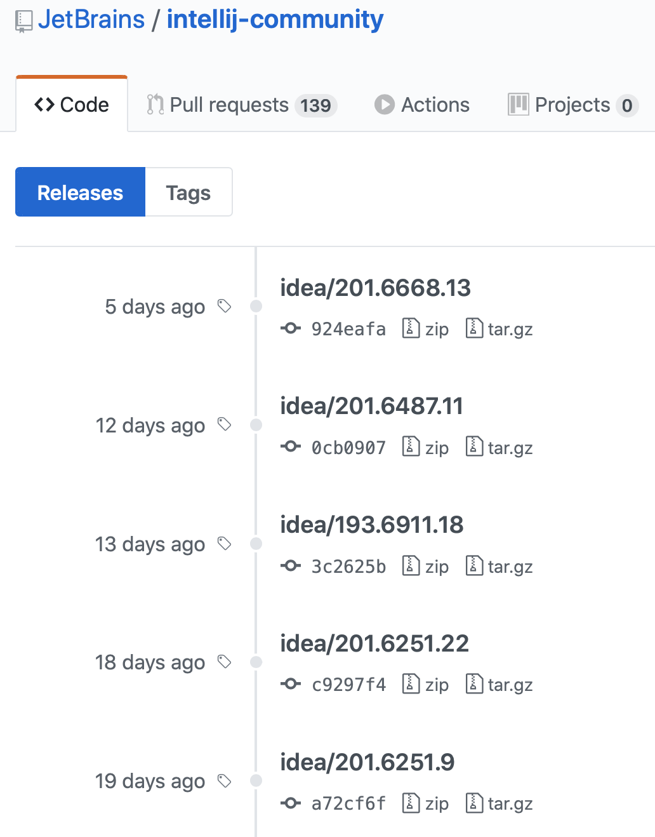
Software systems are constantly changing
New versions are created to handle software changes
Each version may have to be maintained and managed

Slide 5
Multi-version systems
For large systems, there is never just one ‘working’ version of a system.
There are always several versions of the system at different stages of development.
Different versions of the system may be in use

Slide 6
Multi-version system development
Development system
Notes:
Version 1.5 of the system has been developed to repair bug fixes and improve
the performance of the first release of the system. It is the basis of the second
system release (R1.1).
2. Version 2.4 is being tested with a view to it becoming release 2.0 of the system. No new features are being added at this stage.
3. Version 3 is a development system where new features are being added in
response to change requests from customers and the development team. This
will eventually be released as release 3.0.

Slide 7
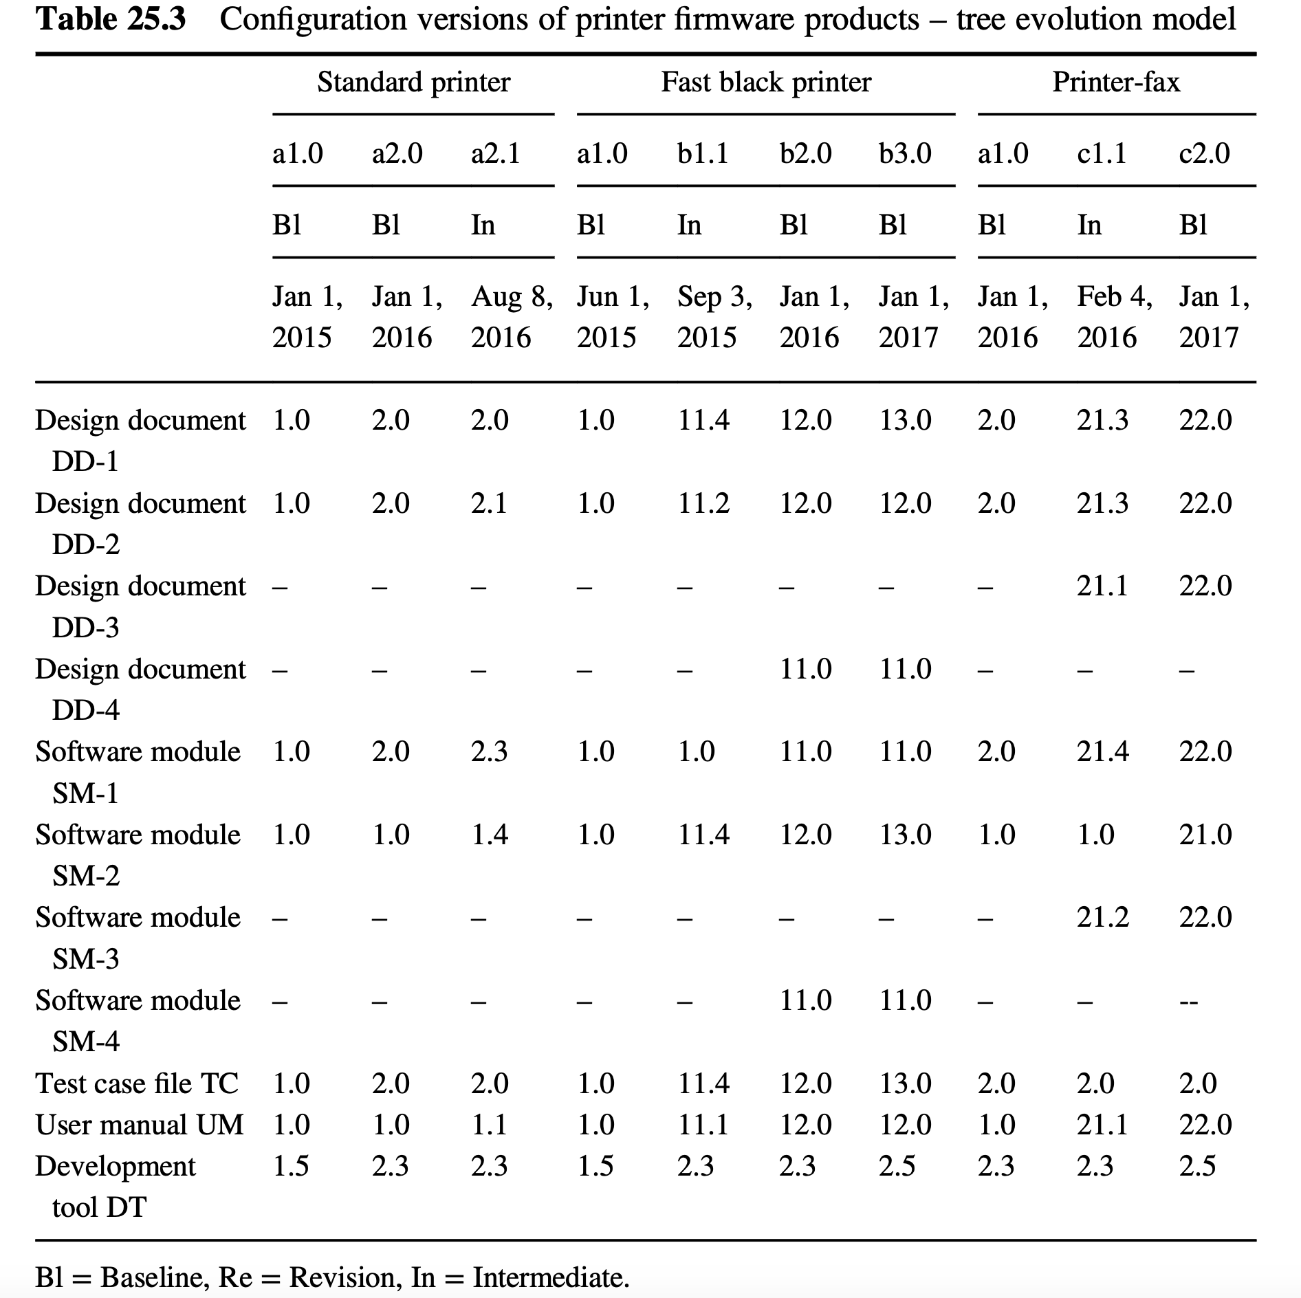
Versions of printer firmware products - a tree evolution model
Even the same component needs different configuration to be maintained and tracked.
In the tree evolution model, one or more new software configuration versions will replace former software configuration version.
Notes:
Manintain different branch for different working system. Even the same component needs different configuration

Slide 8
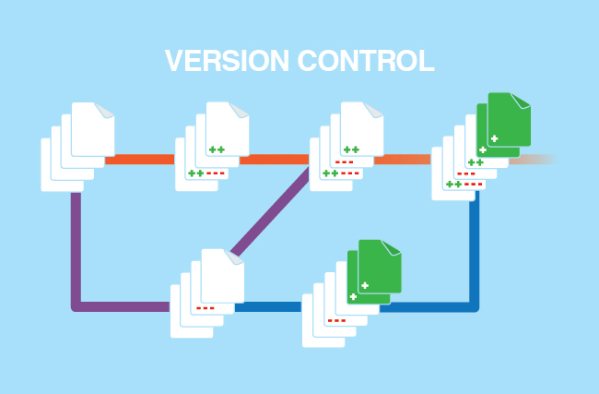
Version control
Version control, also known as source control, is the practice of tracking and managing changes to software code.
Version control systems are software tools that help software teams manage changes to source code over time.

Slide 9
Software item (SCI)
Design documents
Software code
Data files including files of test cases and test scripts
Software development tools

Slide 10
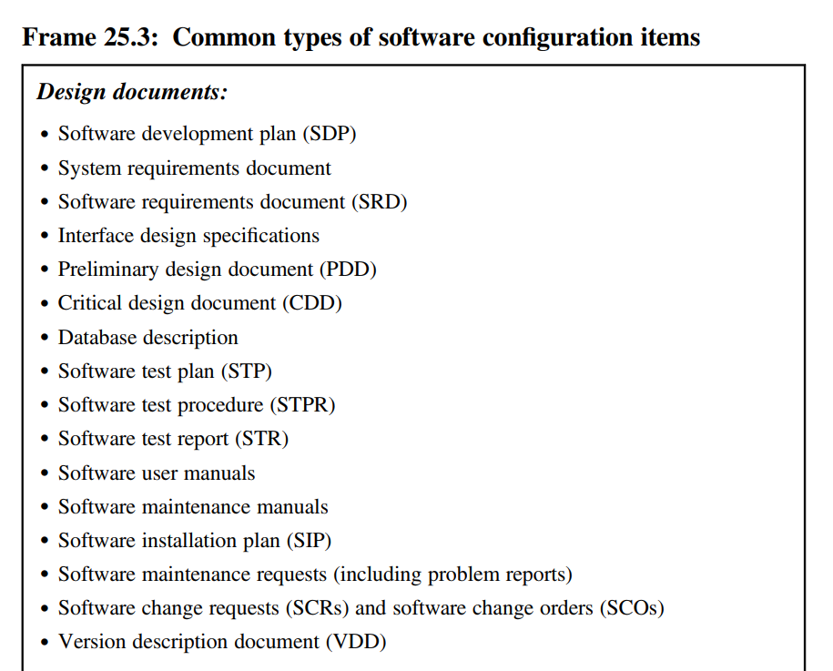

Slide 11
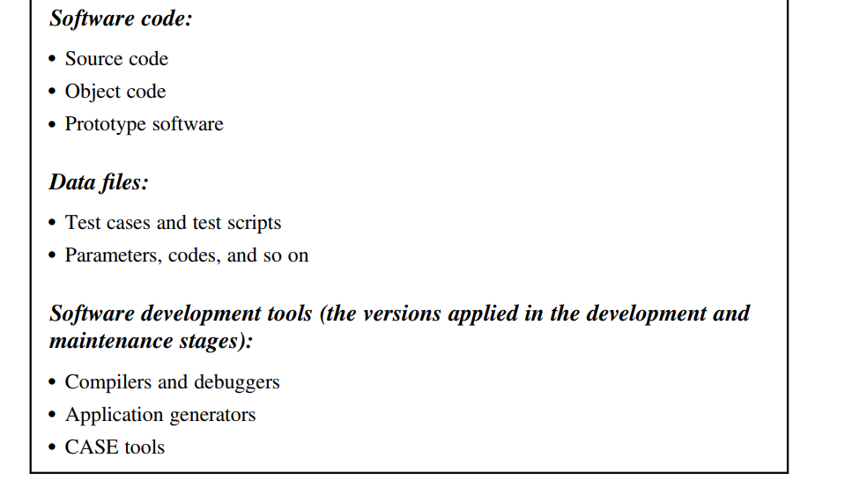
Deployment code, build code
Dataset for machina-learning systems.

Slide 12
Why version control?
A complete long-term change history of every file
having the complete history enables going back to previous versions to help in root cause analysis for bugs
Branching and merging
individuals working on their own can benefit from the ability to work on independent streams of changes.
Traceability
trace each change made to the software and connect it to project management and bug tracking

Slide 13
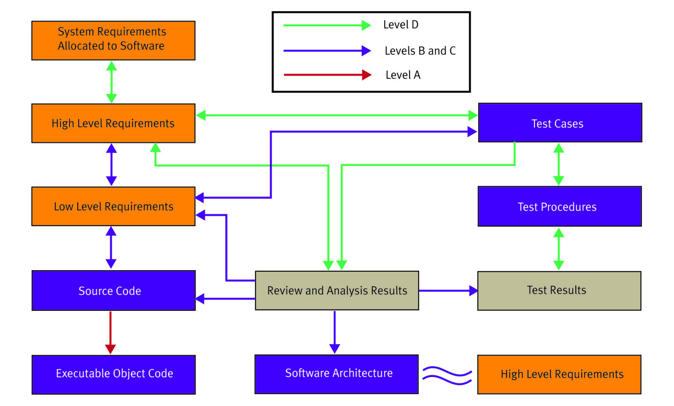
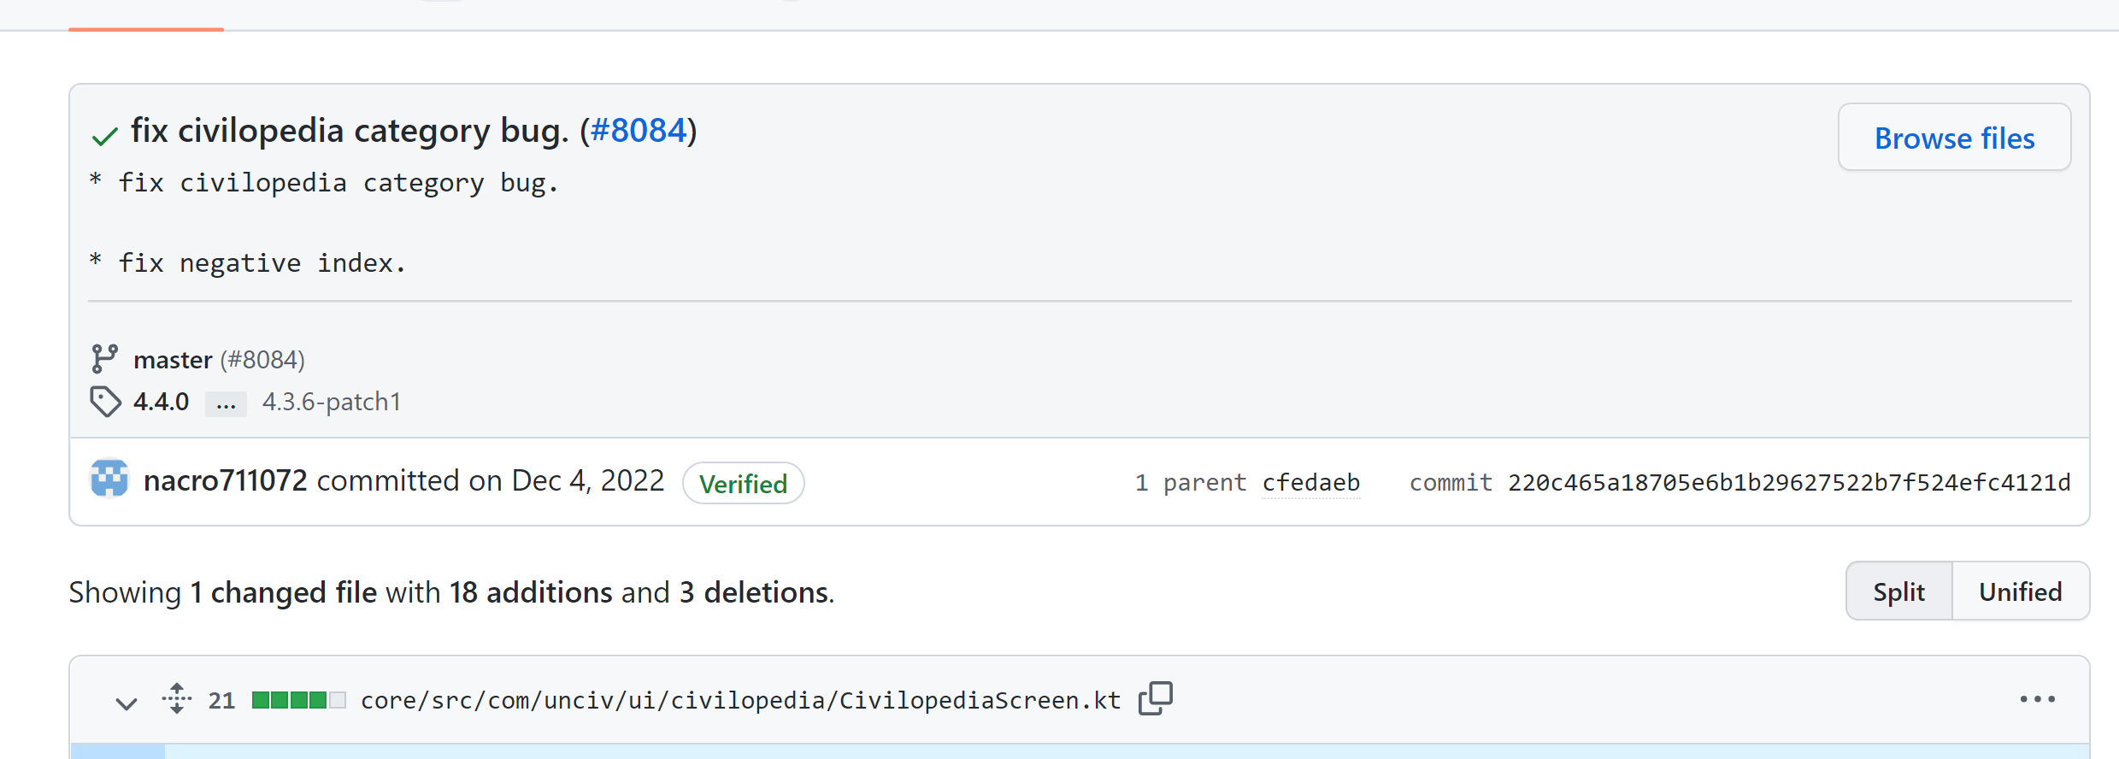
Help traceability in software project
Notes:
Bug fix could be in many applications: bug repair.

Slide 14
Version control
Code
Dependencies
Software configuration
Environment

Slide 15
Code
code management is the process of keeping track of different versions of software code.

Slide 16
Codelines and baselines
code management can be thought of as the process of managing codelines and baselines

Slide 17
Codelines and baselines
A codeline is a sequence of versions of source code with later versions in the sequence derived from earlier versions.
Codelines normally apply to components of systems so that there are different versions of each component.

Slide 18
Codelines and baselines
A baseline is a definition of a specific system.
The baseline therefore specifies the component versions that are included in the system plus a specification of the libraries used, configuration files, etc.
baselines representing different versions of a system
Notes:
Baselines may be specified using a configuration language, which allows you to define what components are included in a version of a particular system.
Baselines are important because you often have to recreate a specific version of a complete system.
For example, a product line may be instantiated so that there are individual system versions for different customers. You may have to recreate the version delivered to a specific customer if, for example, that customer reports bugs in their system that have to be repaired.

Slide 19
Codelines and baselines

Slide 20
Versions of printer firmware products - a tree evolution model
baseline
codeline
In the tree evolution model, one or more new software configuration versions will replace former software configuration version.
Notes:
Manintain different branch for different working system. Even the same component needs different configuration

Slide 21
Version control
Code
Dependencies
Software configuration
Environment

Slide 22
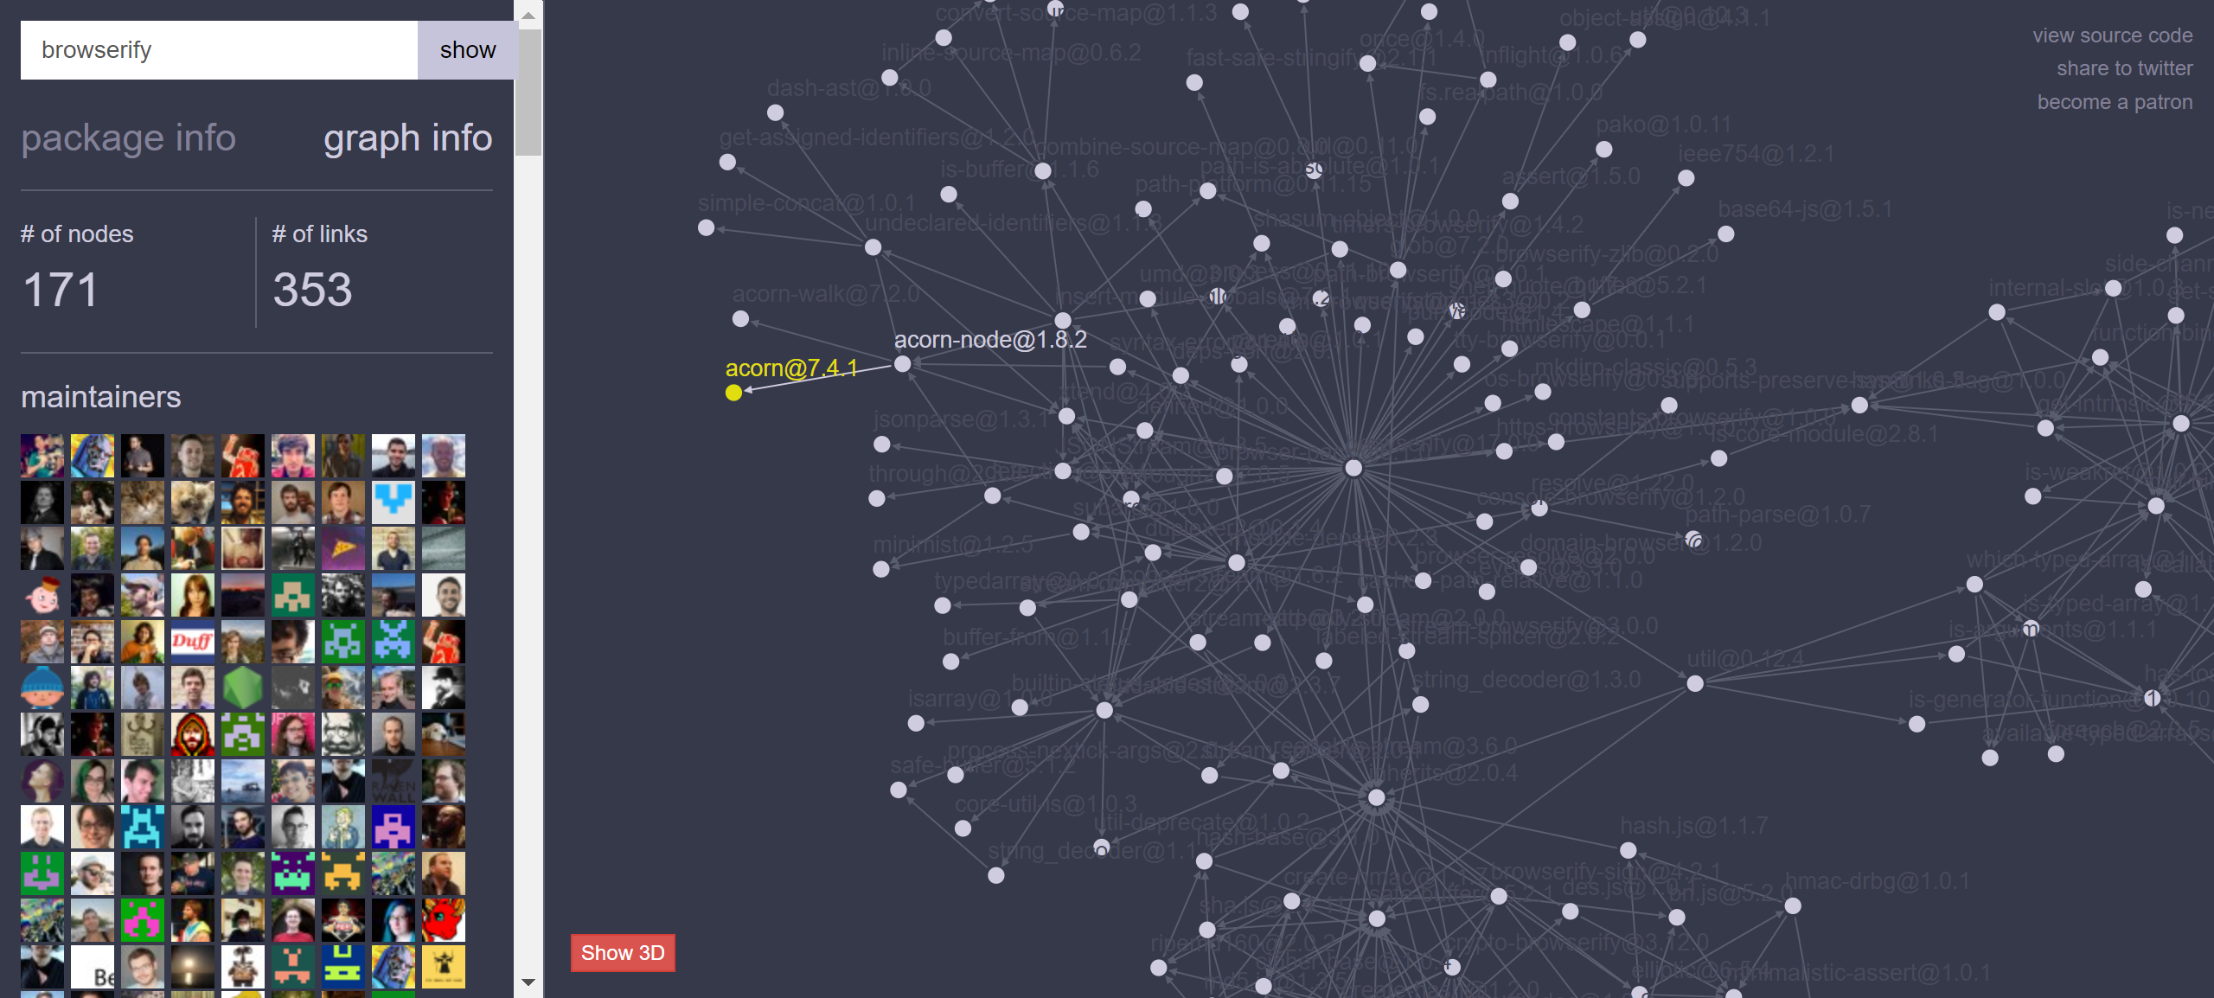
Dependencies graph for browserify in NPM
https://npm.anvaka.com/#/view/2d/browserify
Notes:
Browserify is an open-source JavaScript bundler tool that allows developers to write and use Node.js-style modules that compile for use in the browser.
npm is the default package manager for the JavaScript runtime environment Node.js.

Slide 23
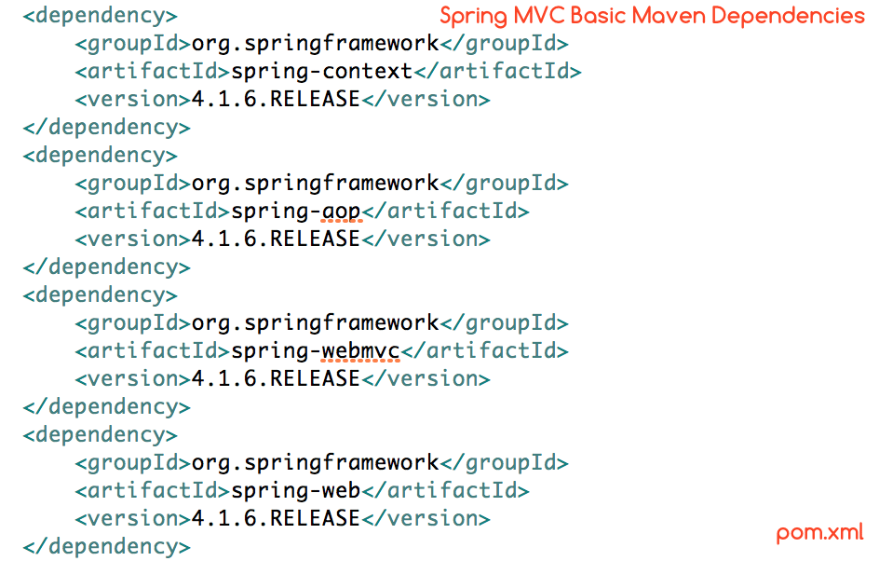

Slide 24
Manage external libraries
Keep locally
Pros: Get started on a project faster. It also means you always have the ability to reproduce your build
Cons: Get repo bigger and check out longer
Download from internet
Pros: The repository gets smaller and check out faster
Cons: Easy to break (get removed from the online repo), safety
Build local external libraries repo in company
In the case of Maven, you should create a repository for your organization containing approved versions of libraries to use

Slide 25
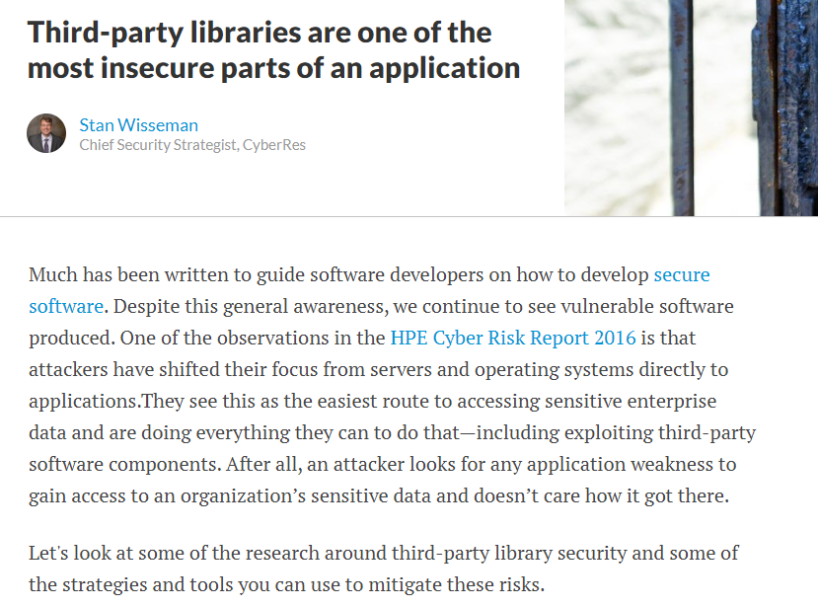

Slide 26
Version control
Code
Dependencies
Software configuration
Environment

Slide 27
Software configuration management
Configuration information can be used to change the behavior of software at build time, deploy time, and run time, which provides flexibility to software.
Suggest to treat the configuration of your system in the same way you treat your code: Make it subject to proper management and testing.

Slide 28
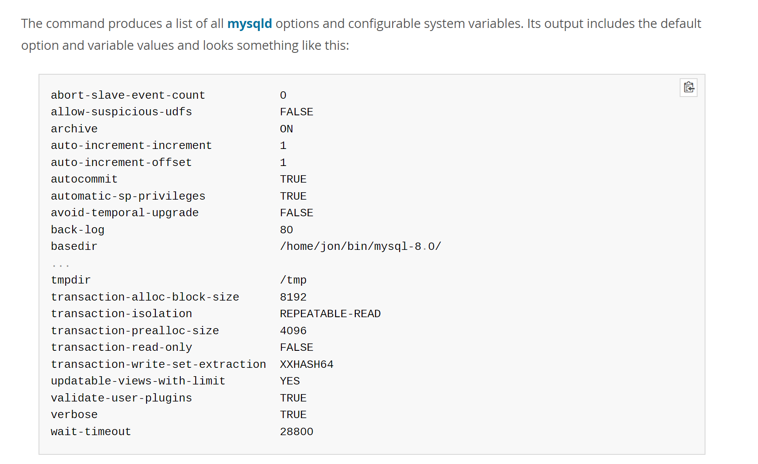
MySQL configuration parameters

Slide 29
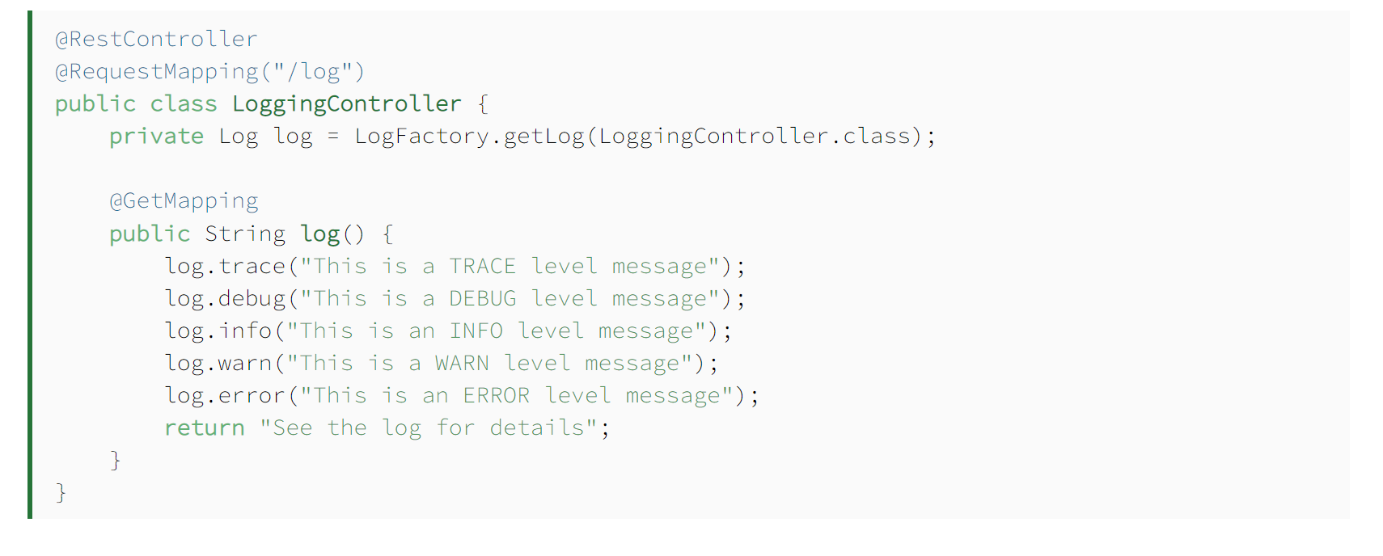
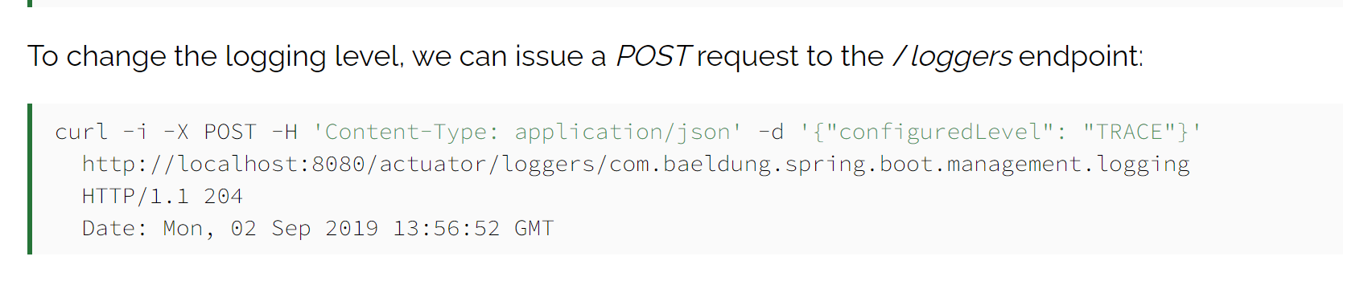
Change log level during runtime in Spring Boot

Slide 30
Flexibility usually comes at a cost!
Make the requirements of system very complicated
Make the system behavior more complicated and harder to test
…

Slide 31
Type of configuration
Configuration information can be injected into your application at several points in your build, deploy, test, and release process.
Your build scripts can pull configuration in and incorporate it into your binaries at build time (e.g., executable is based on configuration).
Your deployment scripts or installers can fetch the necessary information or ask the user for it and pass it to your application at deployment time as part of the installation process (e.g., end-user application).
Your application itself can fetch configuration at startup time or run time.

Slide 32
Version control
Code
Dependencies
Software configuration
Environment

Slide 33
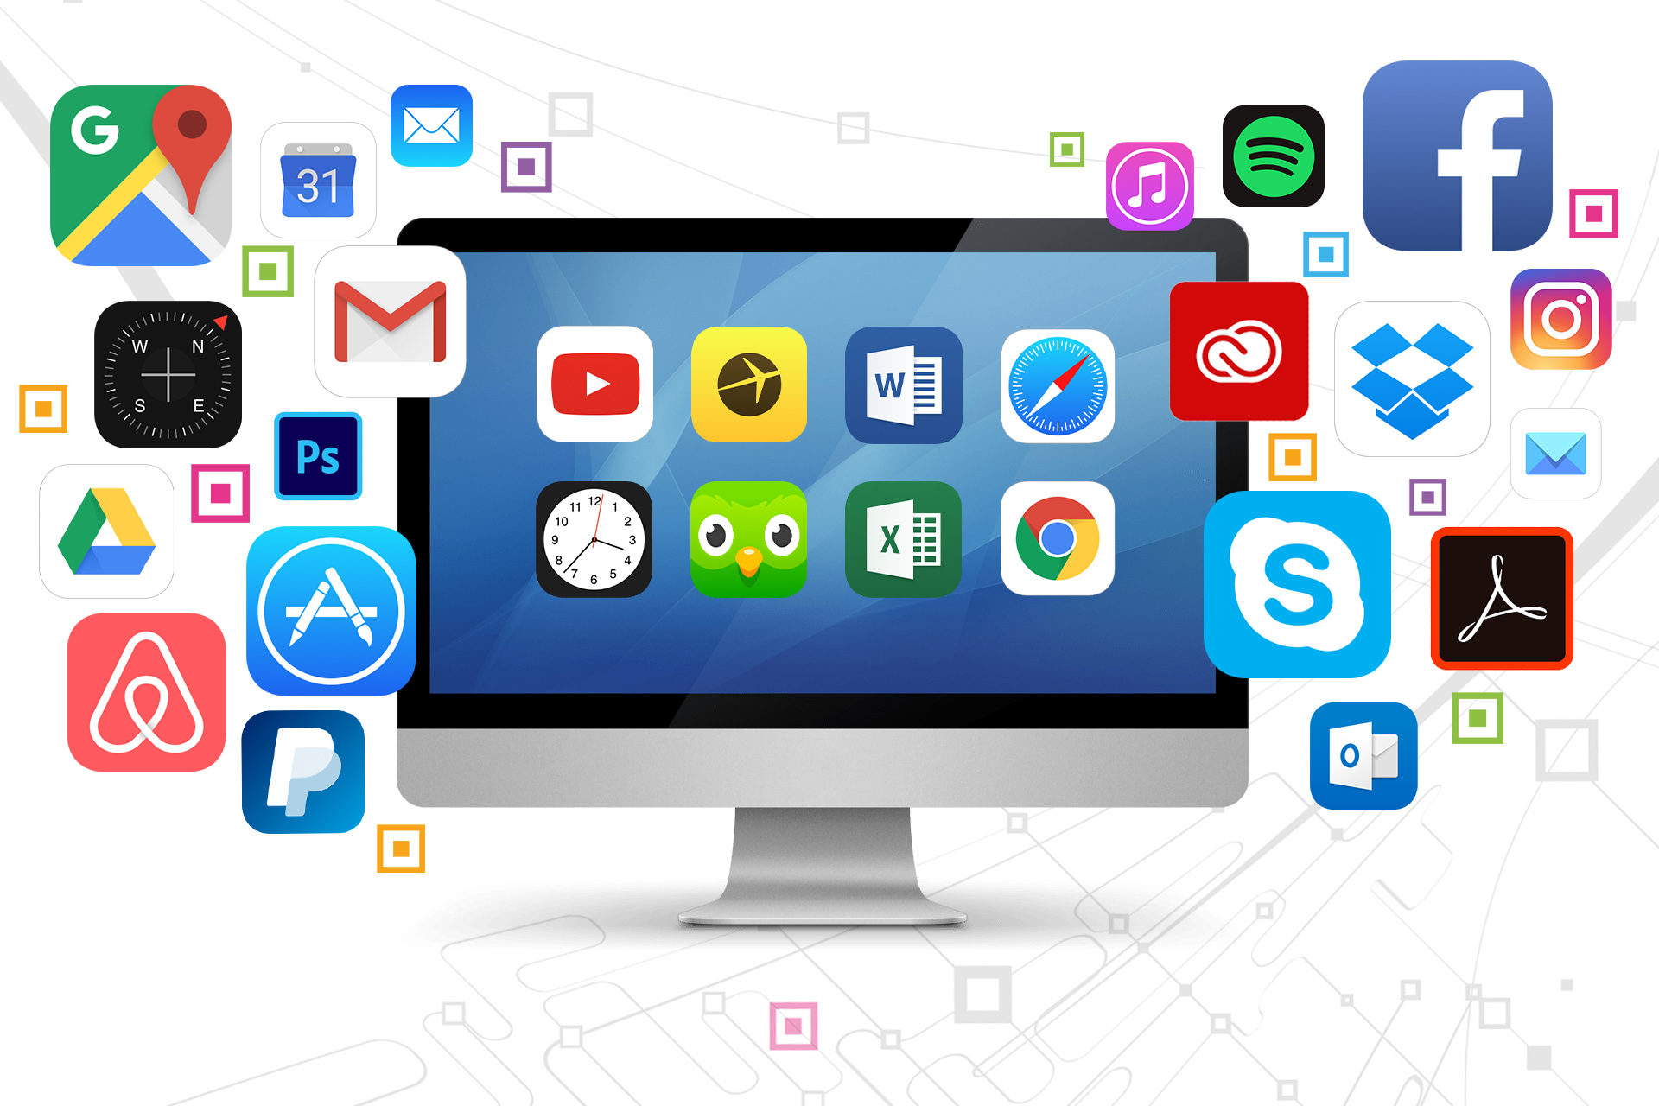
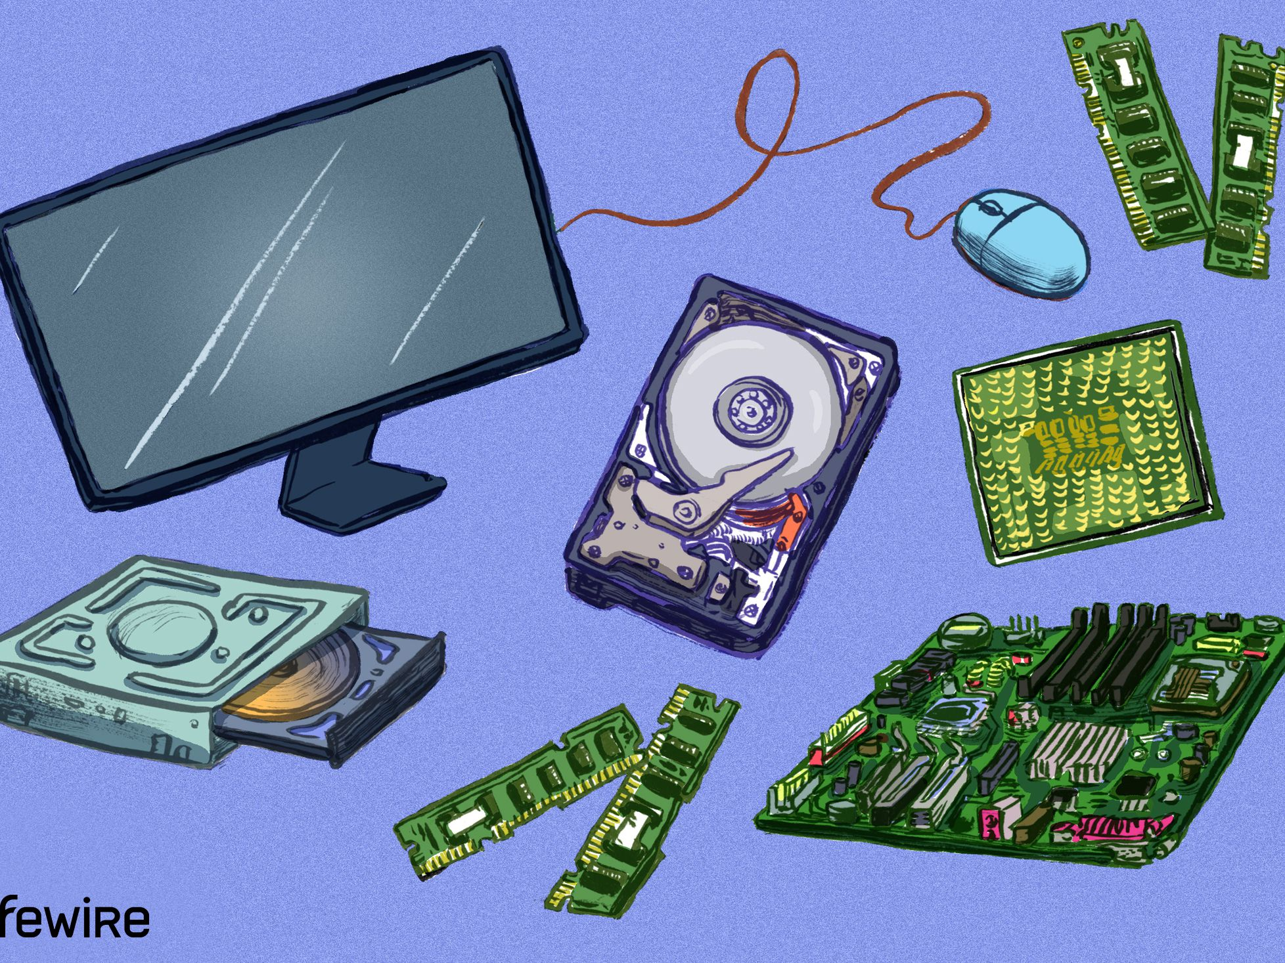
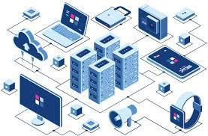
Environment
Software
Hardware
Infrastructure

Slide 34
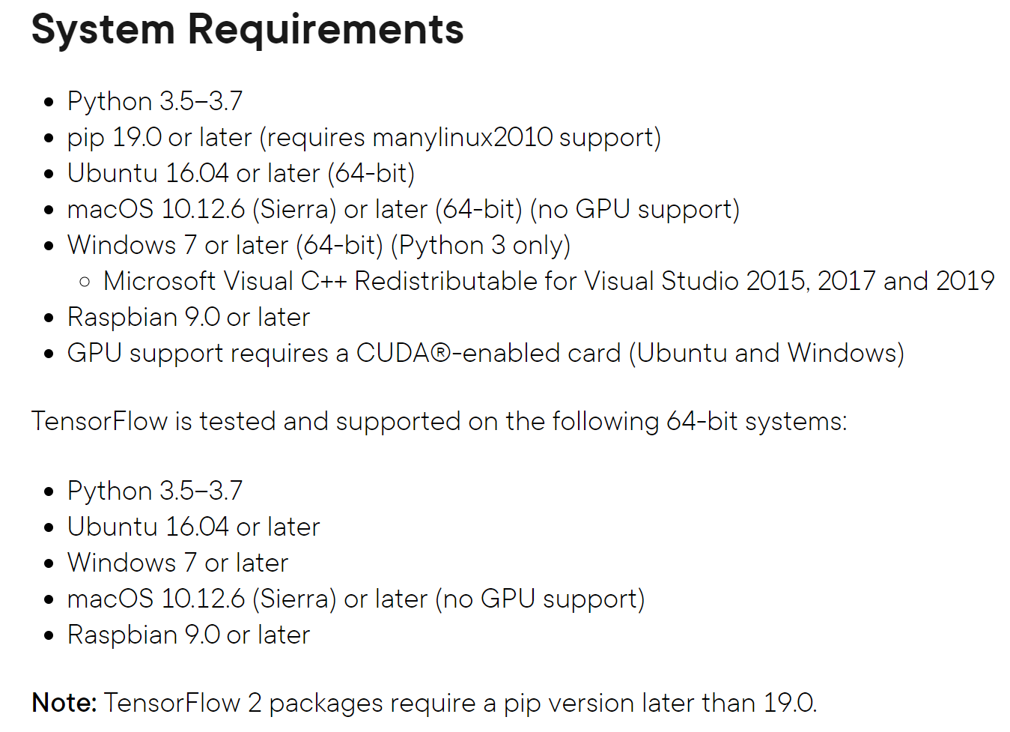

Slide 35
Types of environment configuration
The various operating systems in your environment (versions, patch levels, and configuration settings).
The additional software packages that need to be installed on each environment to support your application, including their versions and configuration.
Any external services that your application depends upon, including their versions and configuration.
Any data or other state that is present in them (for example, production databases).
The networking topology required for your application to work

Slide 36
Key principle - make their creation a fully automated process.
Reduce risk - It removes the problem of having random pieces of infrastructure around whose configuration is only understood by somebody who has left the organization and cannot be reached. When such things stop working, you can usually assume a significant downtime. This is a large and unnecessary risk.
Replicability - It is essential to be able to create copies of production environments for testing/deployment purposes. In terms of software configuration, testing environments should be exact replicas of the production ones, so configuration problems can be found early.

Slide 37

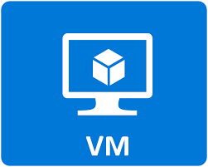
# syntax=docker/dockerfile:1
FROM node:18-alpine
WORKDIR /app
COPY . .
RUN yarn install --production
CMD ["node", "src/index.js"]
EXPOSE 3000

Slide 38
Version control systems
Version control systems (VCS) identify, store and control access to the different versions of components. There are two types of modern version control system
Centralized systems
There is a single master repository that maintains all versions of the software components that are being developed.
Subversion is an example of a centralized VC system.
Distributed systems
Multiple versions of the component repository exist at the same time.
Git is an example of a distributed VC system.

Slide 39
Key features of version control systems
Version and release identification
Managed versions of a component are assigned unique identifiers
Change history recording
Tagging components with keywords describing the changes made; then use these tags to select the components to be included in a baseline.
Support for independent development
Ensures that changes made to a component by different developers do not interfere
Project support
Support the development of several projects which share components
Storage management
Use efficient storage mechanisms (e.g., storing delta, compression)

Slide 40
Benefits of distributed version control
It allows for off-line working so that developers can commit changes if they do not have a network connection.
It provides a backup mechanism for the repository.
If the repository is corrupted, work can continue and the project repository can be restored from local copies.
Project support is the default way of working.
Developers can compile and test the entire system on their local machines and test the changes that they have made.

Slide 41
Open source development
Distributed version control is essential for open source development.
Several people may be working simultaneously on the same system without any central coordination.
Developers also maintain a public server repository to which they push new versions of components that they have changed.
It is then up to the open-source system ‘manager’ to decide when to pull these changes into the definitive system.

Slide 42
Storage management
Disk space was expensive decades ago and it was important to minimize the disk space used by the different copies of components.
Instead of keeping a complete copy of each version, some VCS systems stores a list of differences (deltas) between one version and another.
By applying these to a master version (usually the most recent version), a target version can be recreated.
One of the problems of the delta-based approach is that it can take a long time to apply all of the deltas

Slide 43
Storage management using deltas
Rebuilding Version V1.3 to V1.1, it has to rebuilt V1.2 by applying D3, and then rebuild V1.1 by applying D2.
Notes:
The shaded boxes represent earlier versions of a component that
are automatically re-created from the most recent component version.
Deltas are usually stored as lists of changed lines.

Slide 44
Storage management in Git
Git uses an alternative, faster approach.
Git does not use deltas but applies a standard compression algorithm to stored files and their associated meta-information for speed.
Retrieving a file simply involves decompressing it, with no need to apply a chain of operations.
https://stackoverflow.com/questions/43359590/git-internals-how-does-git-store-small-differences-between-revisions

Slide 45
Tips
Keep Absolutely Everything in Version Control
Check In Regularly to Trunk
Use Meaningful Commit Messages
Keep reasonable size of each push
Notes:
Keep commit atomicity

Slide 46
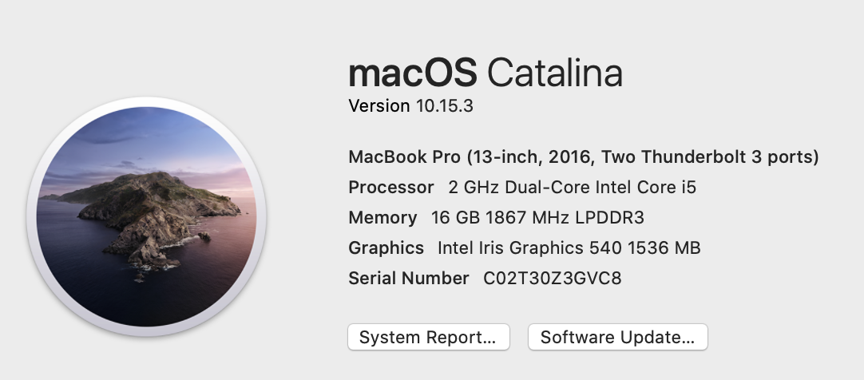
Semantic versioning of software releases
What do the numbers mean?

Slide 47
Semantic versioning of software releases

Slide 48
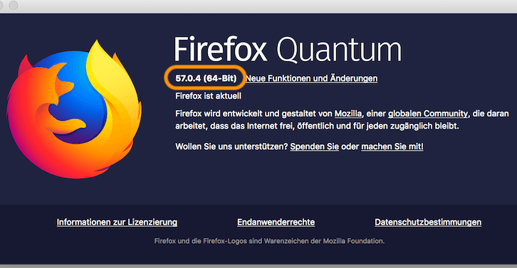

Best practices for versioning a release – https://blog.codeship.com/best-practices-when-versioning-a-release/
Good example
Bad example

Slide 49

Activity1: Introduce to each other
Group in a four/five people surrounding you
5-10 minutes
Introduce yourself a bit
Share your experience of version control, e.g., challenges, tips

Slide 50
Agenda
Version control
Coding practice

Slide 51
Understandability: What to keep in mind?
Code is read by humans!
Code describes what a computer should do
Yet, it is still mainly read by people
As such, it should be written with people in mind
Notes:
This may seem counterintuitive, but code is read by humans more often than it is read by a machine
Mention deep code
Until skynet becomes active, for the time being, humans are maintaining and extending computer programs
It is really important that computer programs be written with other people in mind!

Slide 52

What does this code do?
#include <stdio.h>
#define C(a) ((a)*(a)*(a))
int main(){int x,y;for(y=9;y>-6;y--){for(x=-8;x<9;x++)
putchar(C(x*x+y*y-25)<25*x*x*y*y*y?"LOVE"[(x+10)%4]:'-');
putchar('\n');}
return 0;}
Notes:
Can anyone guess what this code does?
<Show that it draws a heart>
http://cpp.sh/
While the program is error-free, it has many problems for understandability
It looks like what non-technical people fear computer programs look like:
https://www.youtube.com/watch?v=hkDD03yeLnU

Slide 53
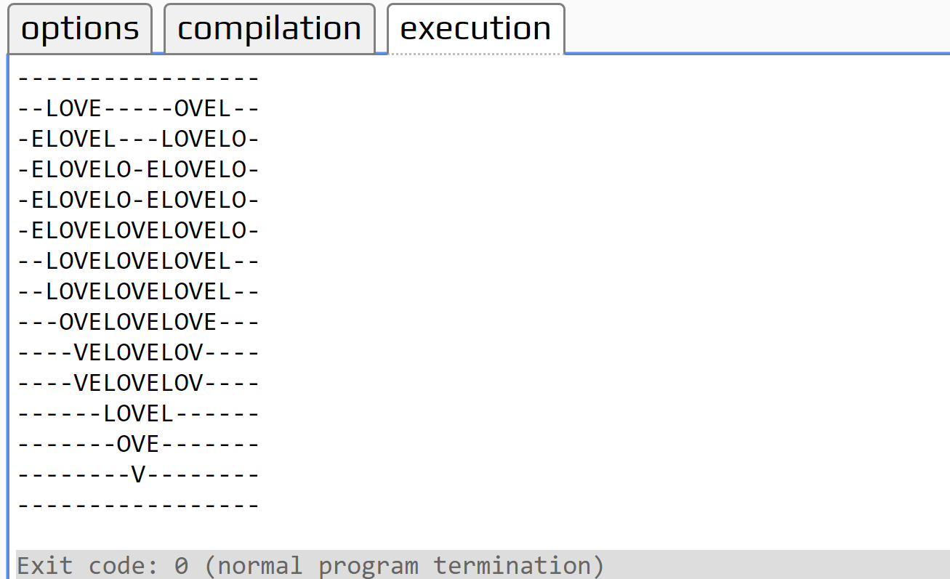

Slide 54

How can we write
understandable
code?
Notes:
It doesn’t have to be understandable to all people, but it better be understandable to other technical people (i.e., members of your development team)

Slide 55
Tips
Use meaningful identifier names!
Add comments that complement the code!
Notes:
I can see that this loops 10 times!
What is not visible in the code is “why”
When the rationale for a coding choice is not clear, please add a comment.

Slide 56
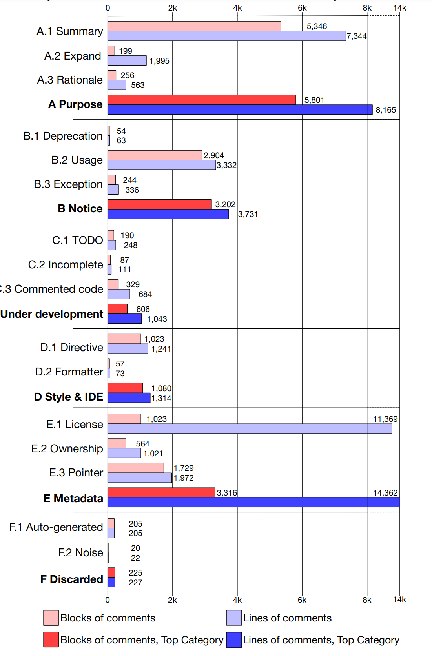
Classifying Code Comments in Java Open-Source Software Systems
https://ieeexplore.ieee.org/abstract/document/7962372

Slide 57
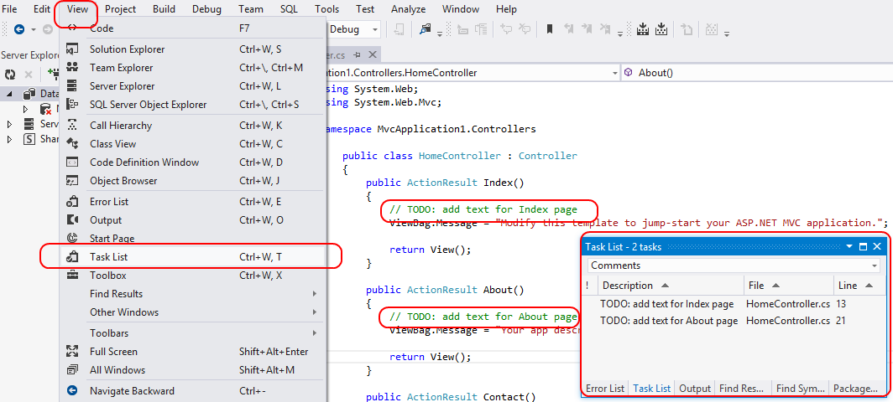
Classifying Code Comments in Java Open-Source Software Systems
https://ieeexplore.ieee.org/abstract/document/7962372

Slide 58
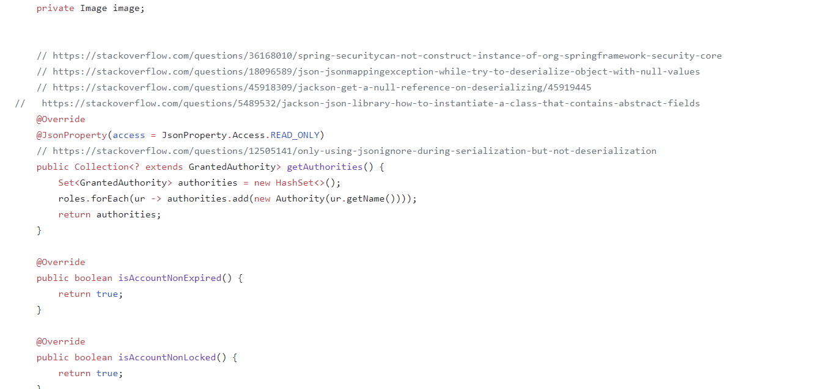
Classifying Code Comments in Java Open-Source Software Systems
https://ieeexplore.ieee.org/abstract/document/7962372

Slide 59
Classifying Code Comments in Java Open-Source Software Systems
https://ieeexplore.ieee.org/abstract/document/7962372

Slide 60
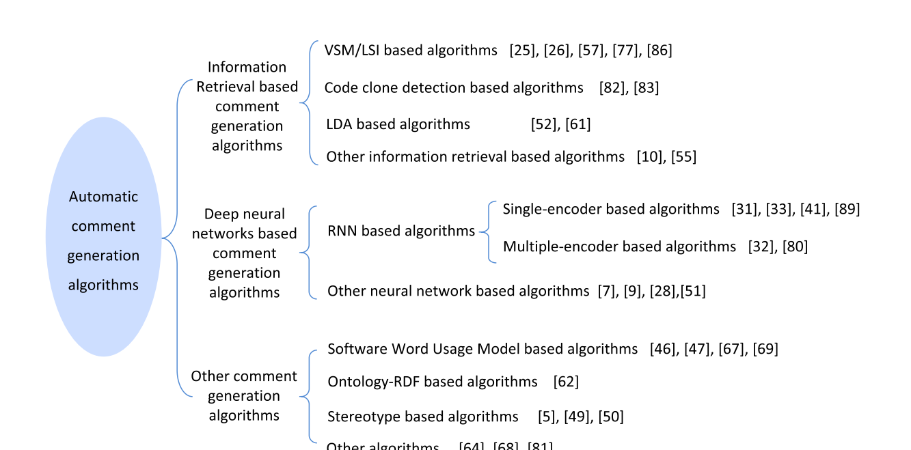

Research on automated comment generating
https://ieeexplore.ieee.org/stamp/stamp.jsp?arnumber=8778714

Slide 61
New code
Comment1
Comment 2
Comment 3
Code 1
Code 2
Code 3
Codebase
Notes:
Find similar codes for new code, and using their existing comment as the comment for new code. Assumption is the duplicated code is existing.

Slide 62

Research on automated comment generating
https://ieeexplore.ieee.org/stamp/stamp.jsp?arnumber=8778714

Slide 63
DEEP NEURAL NETWORKS BASED COMMENT GENERATION ALGORITHMS
Sequence to Sequence Model
Sequence-to-sequence model (Seq2Seq) is models that convert sequences from one domain (e.g. sentences in English) to sequences in another domain (e.g. the same sentences translated to French).
"the cat sat on the mat" -> [Seq2Seq model] -> "le chat etait assis sur le tapis"

Slide 64
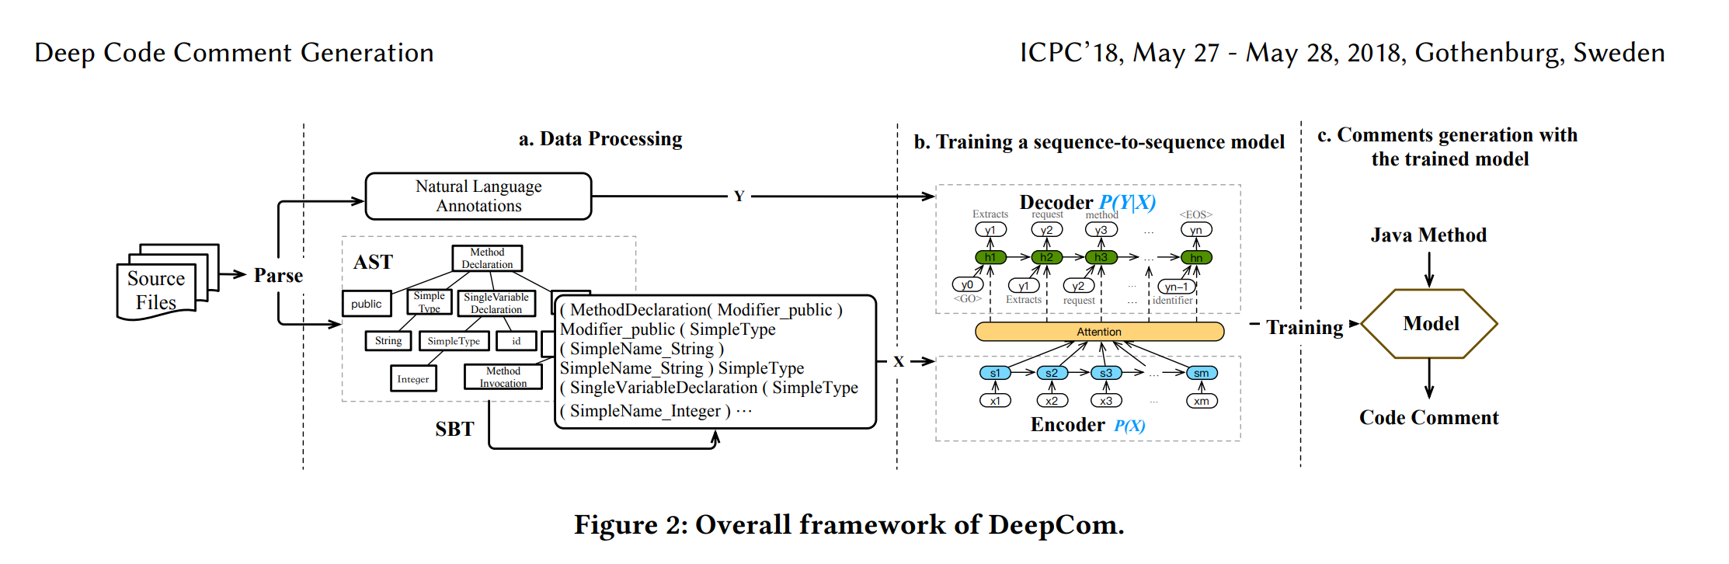
https://xin-xia.github.io/publication/icpc182.pdf

Slide 65
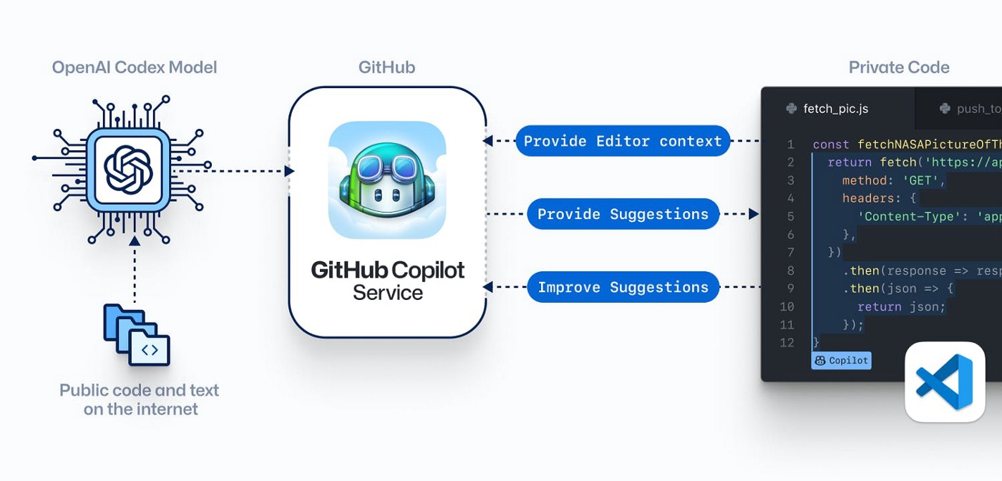
Pair programming with AI

Slide 66
Understandability tip #3:
Coding conventions are a set of guidelines for a specific programming language that recommend programming style, practices, and methods for each aspect of a program written in that language.

Slide 67


https://google.github.io/styleguide/
https://mechatronics.me.wisc.edu/labresources/DataSheets/NASA-GSFC_C_Programming_Styles-94-003.pdf

Slide 68
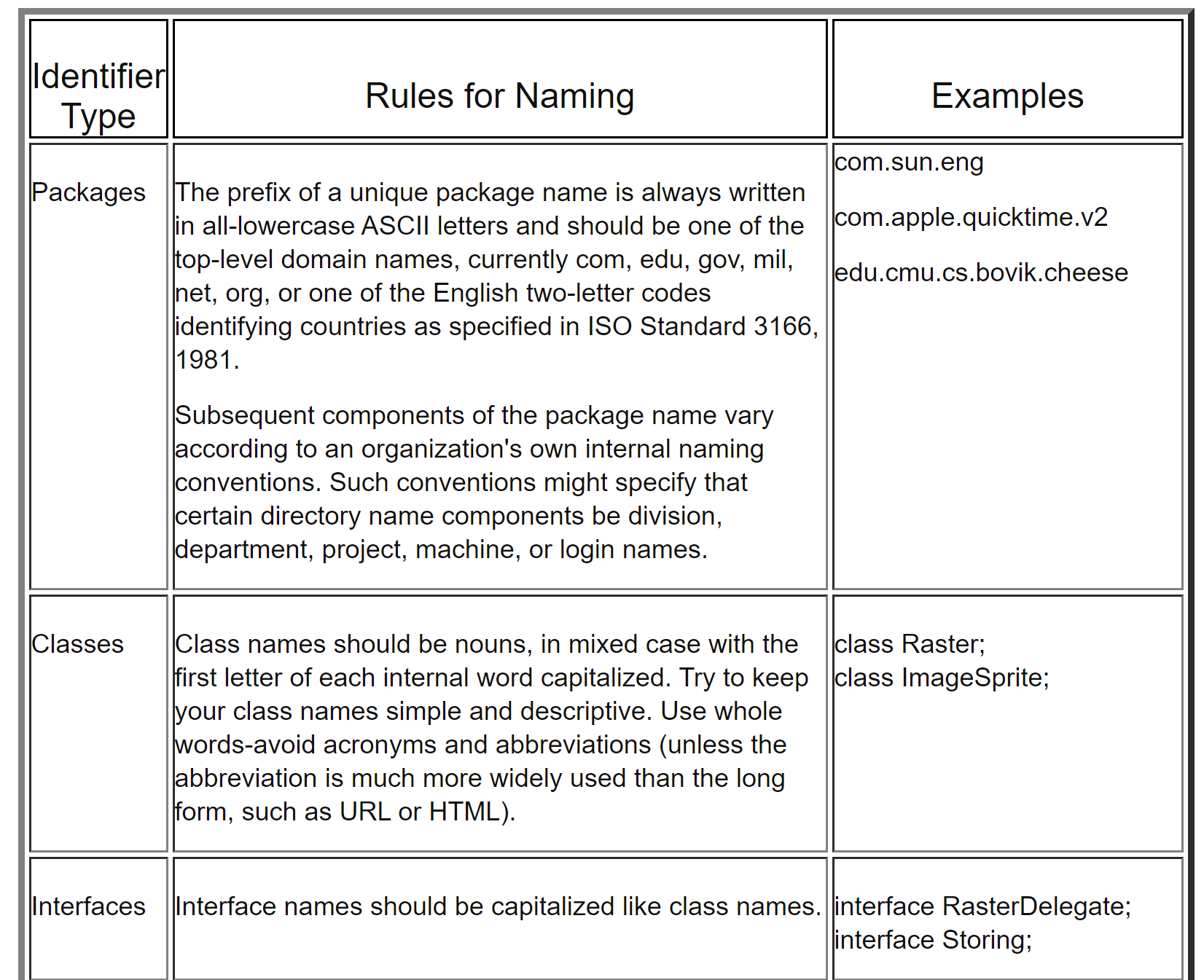

Slide 69
References
Jez Humble and David Farley, Continuous Delivery, Chapter 2 (Configuration Management)
Ian Sommerville, Software Engineering, 10th Edition, Chapter 25 (Configuration Management)

Slide 70
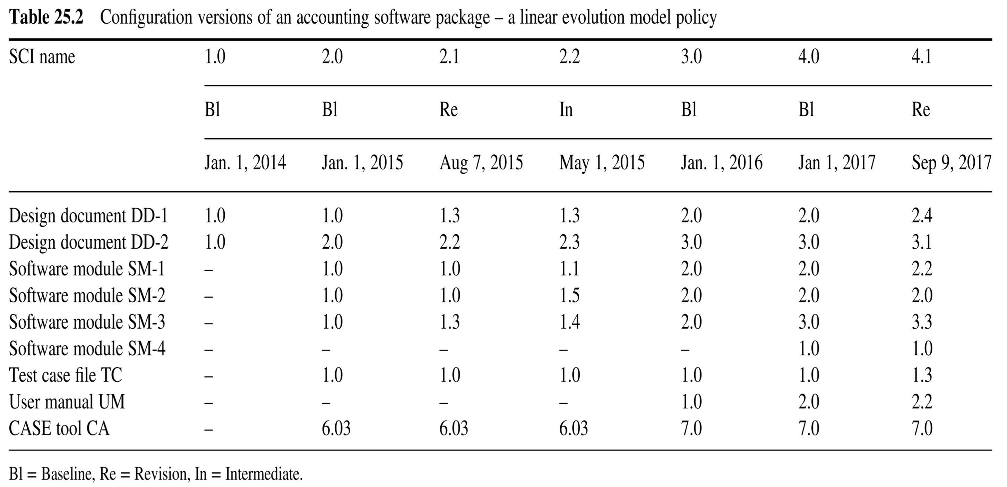
Versions of an accounting software package - a linear evolution model
In the linear evolution model, only one new software configuration version will replace the former “old” software configuration version.

Slide 71
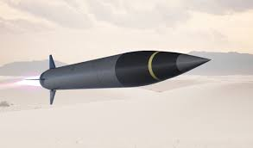

Configuration management
The CM process is widely used by other domains, such as weapon systems, military vehicles, civil engineering and other industrial engineering segments such as roads, bridges, canals, dams, and buildings.

